Slide 1
11. Performance
Lars Class Copy – LCCF21
1.1–1.2
Notes:
Learning Objectives
(11.1a) Explain algorithmic efficiency as it relates to speed and space consumption.
(11.1b) Recognize typical orders of complexity (O(1), O(log n), O(n), O(n log n), O(n^2), O(n^3), O(2^n))
(11.1c) Identify the basic operations in an algorithm and determine the running time of an algorithm by counting its basic operations.
(11.1d) Express the running time of an algorithm as a function of the input size and derive the complexity class of the algorithm.
(11.1e) Categorize algorithms according to their Big O complexity.
(11.1f) Describe space and time efficiency tradeoffs when designing algorithms.
(11.1g) Identify the best case, worst case, and average case Big O complexities of algorithms.
(11.1h) Compare the efficiencies of different algorithms that perform the same task.

Slide 2
11. Performance
The challenge
Empirical analysis
Mathematical models
Doubling method
Familiar examples
Adopted and modified from Slides by Sedgewick and Wayne

Slide 3
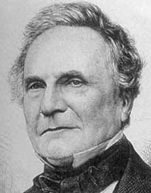
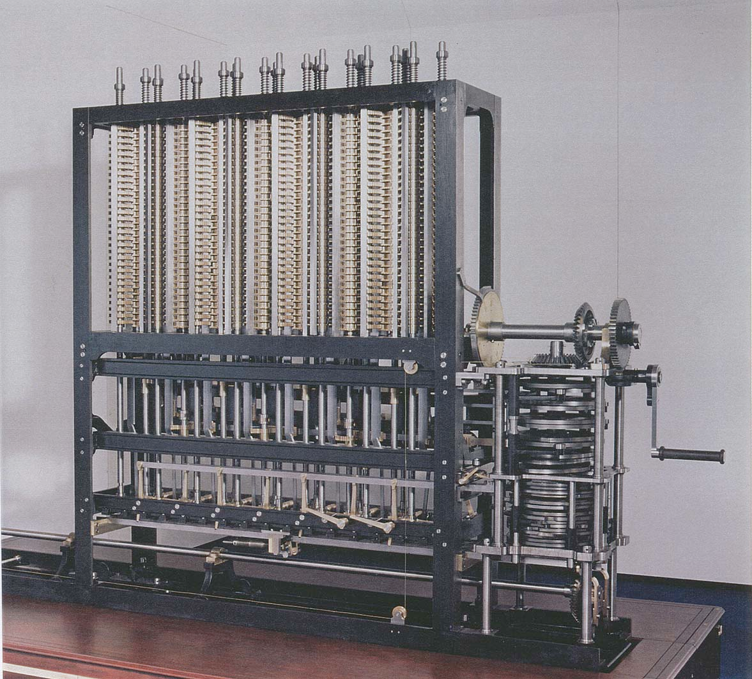
The challenge (since the earliest days of computing machines)
“ As soon as an Analytic Engine exists, it will necessarily guide the future course of the science. Whenever any result is sought by its aid, the question will arise—By what course of calculation can these results be arrived at by the machine in the shortest time?”
− Charles Babbage
Difference Engine #2
Designed by Charles Babbage, c. 1848
Built by London Science Museum, 1991
Q. How many times do you have to turn the crank?

Slide 4

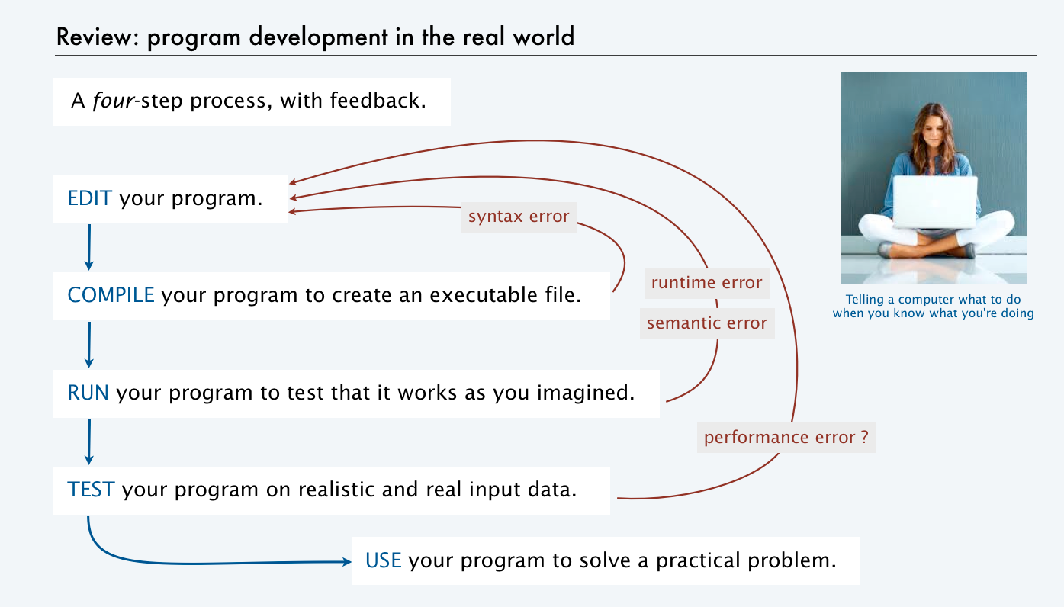
The challenge (modern version)
Q. Will I be able to use my program to solve a large practical problem?
Q. If not, how might I understand its performance characteristics so as to improve it?
Key insight (Knuth 1970s). Use the scientific method to understand performance.

Slide 5
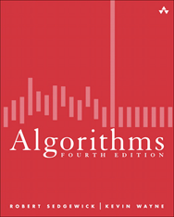
Three reasons to study program performance
public class Gambler
{
public static void main(String[] args)
{
int stake = Integer.parseInt(args[0]);
int goal = Integer.parseInt(args[1]);
int trials = Integer.parseInt(args[2]);
int wins = 0;
for (int t = 0; t < trials; t++)
{
int cash = stake;
while (cash > 0 && cash < goal)
if (Math.random() < 0.5) cash++; else cash--;
if (cash == goal) wins++;
}
StdOut.print(wins + " wins of " + trials);
}
}
1. To predict program behavior
Will my program finish?
When will my program finish?
2. To compare algorithms and implementations.
Will this change make my program faster?
How can I make my program faster?
3. To develop a basis for understanding the problem and for designing new algorithms
Enables new technology.
Enables new research.
An algorithm is a method for solving a problem that is suitable for implementation as a computer program.
We study several algorithms later in this course. Taking more CS courses? You'll learn dozens of algorithms.
Notes:
Analysis of algorithms. Framework for comparing algorithms and predicting performance.

Slide 6
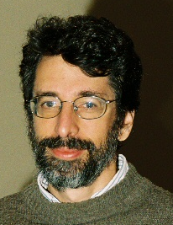
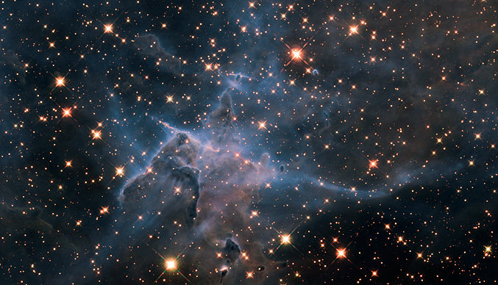
An algorithm design success story
N-body simulation
Goal: Simulate gravitational interactions among N bodies.
Brute-force algorithm uses N² steps per time unit.
Issue (1970s): Too slow to address scientific problems of interest.
Success story: Barnes-Hut algorithm uses NlogN steps and enables new research.
Andrew Appel
Princeton '81
senior thesis
N²
time
limit on available time
NlogN
problem size (N)

Slide 7
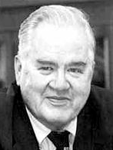
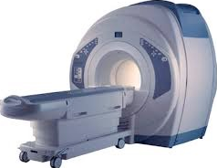


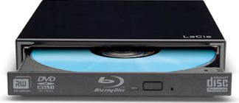
Another algorithm design success story
Discrete Fourier transform
Goal: Break down waveform of N samples into periodic components.
Applications: digital signal processing, spectroscopy, ...
Brute-force algorithm uses N² steps.
Issue (1950s): Too slow to address commercial applications of interest.
Success story: FFT algorithm uses NlogN steps and enables new technology.
John Tukey
1915–2000
N²
time
limit on available time
NlogN
problem size (N)

Slide 8
Quick aside: binary logarithms
Def. The binary logarithm of a number N (written lg N) is the number x satisfying 2^{x} = N.
4
3
lg N
2
1
or log2N
0
 | 1 | 2 |  | 4 |  |  |  | 8 |  |  |  |  |  |  |  | 16
Q. How many recursive calls for convert(N)?
N
Frequently encountered values
public static String convert(int N)
{
if (N == 1) return "1";
return convert(N/2) + (N % 2);
}
N | approximate value | lgN | log10N
2¹⁰ | 1 thousand | 10 | 3.01
2²⁰ | 1 million | 20 | 6.02
2³⁰ | 1 billion | 30 | 9.03
A. Largest integer less than or equal to lg N (written ⎣lg N⎦).
Prove by induction.
Details in "sorting and searching" lecture.
Fact. The number of bits in the binary representation of N is 1+⎣lg N⎦.
Fact. Binary logarithms arise in the study of algorithms based on recursively solving problems half the size (divide-and-conquer algorithms), like convert, FFT and Barnes-Hut.

Slide 9
Performance or Efficiency of Algorithms
Efficiency is a measure of speed and space consumption
Speed – time complexity
also called running or execution time
Space consumption – space complexity
memory usage
always less than or equal to the time requirement

Slide 10
An algorithmic challenge: 3-sum problem
Three-sum. Given N integers, enumerate the triples that sum to 0.
For simplicity, just count them.
public class ThreeSum
{
public static int count(int[] a)
{ /* See next slide. */ }
public static void main(String[] args)
{
int[] a = StdIn.readAllInts();
StdOut.println(count(a));
}
}
Applications in computational geometry
Find collinear points.
Does one polygon fit inside another?
Robot motion planning.
[a surprisingly long list]
% more 6ints.txt
30 -30 -20 -10 40 0
% java ThreeSum < 6ints.txt
3
✗
30 | -30 | 0
30 | -20 | -10
-30 | -10 | 40
✗
Q. Can we solve this problem for N = 1 million?
✓
Notes:
Suggestion: Run this program on command line to see how much we can increase the value of N.

Slide 11

Three-sum implementation
"Brute force" algorithm
Process all possible triples.
Increment counter when sum is 0.
i | j | k | a[i] | a[j] | a[k]
0 | 1 | 2 | 30 | -30 | -20
0 | 1 | 3 | 30 | -30 | -10
0 | 1 | 4 | 30 | -30 | 40
0 | 1 | 5 | 30 | -30 | 0
0 | 2 | 3 | 30 | -20 | -10
0 | 2 | 4 | 30 | -20 | 40
0 | 2 | 5 | 30 | -20 | 0
0 | 3 | 4 | 30 | -10 | 40
0 | 3 | 5 | 30 | -10 | 0
0 | 4 | 5 | 30 | 40 | 0
1 | 2 | 3 | -30 | -20 | -10
1 | 2 | 4 | -30 | -20 | 40
1 | 2 | 5 | -30 | -20 | 0
1 | 3 | 4 | -30 | -10 | 40
1 | 3 | 5 | -30 | -10 | 0
1 | 4 | 5 | -30 | 40 | 0
2 | 3 | 4 | -20 | -10 | 40
2 | 3 | 5 | -20 | -10 | 0
2 | 4 | 5 | -20 | 40 | 0
3 | 4 | 5 | -10 | 40 | 0
i | 0 | 1 | 2 | 3 | 4 | 5
a[i] | 30 | -30 | -20 | -10 | 40 | 0
public static int count(int[] a)
{
int N = a.length;
int cnt = 0;
for (int i = 0; i < N; i++)
for (int j = i+1; j < N; j++)
for (int k = j+1; k < N; k++)
if (a[i] + a[j] + a[k] == 0)
cnt++;
return cnt;
}
Keep i < j < k to avoid processing each triple 6 times
triples with i < j < k
Q. How much time will this program take for N = 1 million?
Notes:
good style to declare loop iteration variable in initialization statement.
Example of automatic type conversion from integer to string.
Suggestion: Run this program on a terminal command line to see how much you can increase N

Slide 12
An algorithmic challenge: 3-sum problem (with timing)
Explain algorithmic efficiency as it relates to speed and space consumption.
LO 11.1a
Three-sum. Given N random integers, enumerate the triples that sum to 0.
N | time
10
100
public class ThreeSum
{
public static int count(int[] a)
{ /* See previous slide. */ }
public static void main(String[] args)
{
int N = Integer.parseInt(args[0]);
int[] a = new int[N];
Random r = new Random();
for (int i=0; i< N; i++)
a[i] = r.nextInt()
StdOut.println(count(a));
}
}
% java ThreeSum 10000
1000
10000
1000000
10⁹ | ??
10¹² | ??
10¹⁵ | ??
Q. Complete the table for N=10, 100, 1000, …
Notes:
(11.1a) Explain algorithmic efficiency as it relates to speed and space consumption.
Suggestion: Run this program on command line to see how much we can increase the value of N.

Slide 13
Memory usage by a program
Explain algorithmic efficiency as it relates to speed and space consumption.
LO 11.1a
Memory. It is possible to count how much memory might be used by a program.
public static int[ ] reverse(int[ ] a) {
int n = a.length;
for (int i=0; i< a.length/2; i++) {
int tmp = a[i];
a[i] = a[n-i-1];
a[n-i-1] = tmp;
}
return a;
}
Q. Assuming ints are 4 bytes, what is the total memory requirement for reverse function?
A. 4n + 4 + 4 + 4 = 4n + 12
Notes:
(11.1a) Explain algorithmic efficiency as it relates to speed and space consumption.
Suggestion: Run this program on command line to see how much we can increase the value of N.
4n (array of n ints) + 4 (n) + 4(i) + 4 (tmp)

Slide 14
7. Performance
The challenge
Empirical analysis
Mathematical models
Doubling method
Familiar examples

Slide 15
A first step in analyzing running time
Find representative inputs
Option 1: Collect actual input data.
Option 2: Write a program to generate representative inputs.
Input generator for ThreeSum
% java Generator 1000000 10
28773
-807569
-425582
594752
600579
-483784
-861312
-690436
-732636
360294
public class Generator
{ // Generate N integers in [-M, M)
public static void main(String[] args)
{
int M = Integer.parseInt(args[0]);
int N = Integer.parseInt(args[1]);
for (int i = 0; i < N; i++)
StdOut.println(StdRandom.uniform(-M, M));
}
}
% java Generator 10 10
-2
1
-4
1
-2
-10
-4
1
0
-7
not much chance
of a 3-sum
good chance
of a 3-sum

Slide 16
Empirical analysis
Run experiments
Start with a moderate input size N.
Measure and record running time.
Double input size N.
Repeat.
Tabulate and plot results.
Replace println() in ThreeSum with this code.
Measure running time
double start = System.currentTimeMillis() / 1000.0;
int cnt = count(a);
double now = System.currentTimeMillis() / 1000.0;
StdOut.printf("%d (%.0f seconds)\n", cnt, now - start);
Tabulate and plot results
Run experiments
250
N | time (seconds)
1000 | 0
2000 | 4
4000 | 31
8000 | 248
% java Generator 1000000 1000 | java ThreeSum
59 (0 seconds)
% java Generator 1000000 2000 | java ThreeSum
522 (4 seconds)
% java Generator 1000000 4000 | java ThreeSum
3992 (31 seconds)
% java Generator 1000000 8000 | java ThreeSum
31903 (248 seconds)
200
time (seconds)
100
0
0 | 1000 | 2000 |  | 4000 |  |  |  | 8000
problem size (N)

Slide 17

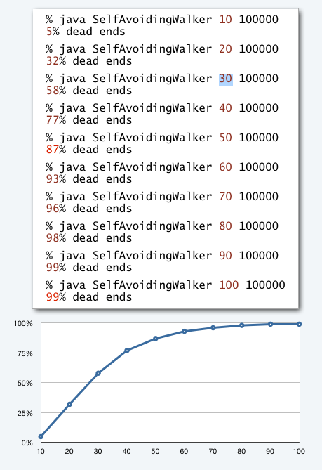
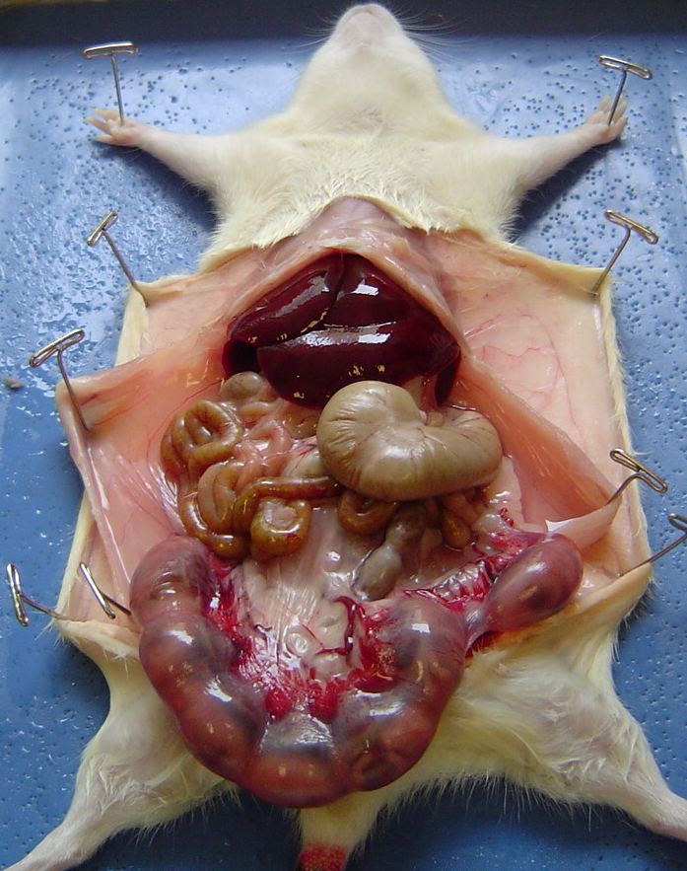
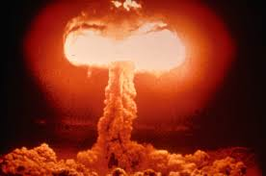
Aside: experimentation in CS
is virtually free, particularly by comparison with other sciences.
one million experiments
one experiment
Chemistry
Biology
Physics
Computer Science
Bottom line. No excuse for not running experiments to understand costs.

Slide 18
Data analysis
Curve fitting
Plot on log-log scale.
If points are on a straight line (often the case), a power law holds—a curve of the form aN^{b} fits.
The exponent b is the slope of the line.
Solve for a with the data.
N | TN | lgN | lg TN
1000 | 0.5 | 10 | −1
2000 | 4 | 11 | 2
4000 | 31 | 12 | 5
8000 | 248 | 13 | 8
4.84 × 10 ⁻¹⁰ × N³
0.5
4
31
248
✓
log-log plot
Do the math
x-intercept (use lg in anticipation of next step)
8
lgTN = lga + 3lgN
equation for straight line of slope 3
5
raise 2 to a power of both sides
straight line
of slope 3
TN = aN³
log time (lg TN)
248 = a × 8000³
substitute values from experiment
2
a = 4.84 × 10 ⁻¹⁰
solve for a
−1
TN = 4.84 × 10 ⁻¹⁰ × N³
substitute
 | 10 | 11 | 12 | 13
log problem size (lg N)
a curve that fits the data ?

Slide 19

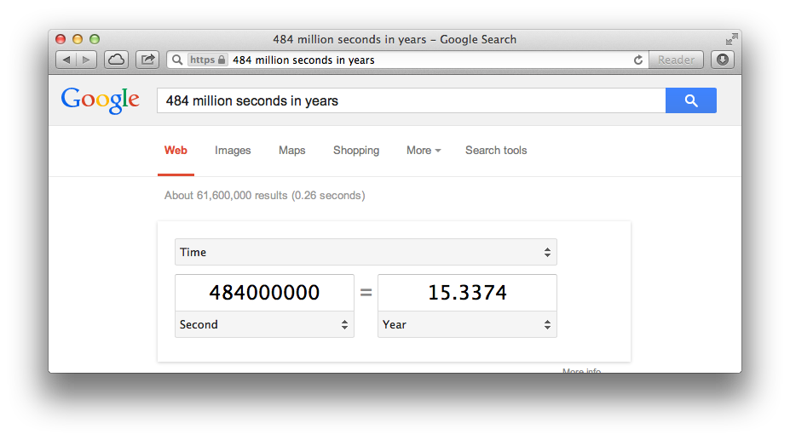
Prediction and verification
Hypothesis. Running time of ThreeSum is 4.84 × 10 ⁻¹⁰ × N³.
Prediction. Running time for N = 16,000 will be 1982 seconds.
about half an hour
% java Generator 1000000 16000 | java ThreeSum
31903 (1985 seconds)
✓
Q. How much time will this program take for N = 1 million?
A. 484 million seconds (more than 15 years).

Slide 20
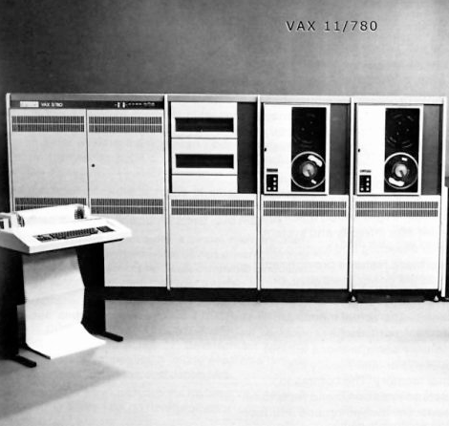

Another hypothesis
1970s
5.2 × 10 ⁻⁶ × N³ seconds
N | time (seconds)
1000 | 5319
2000 | 43221
4000 | 343774
8000 | 2654384
2000000
1000000
(estimated)
0
0 | 1000 | 2000 |  | 4000 |  |  |  | 8000
VAX 11/780
4.84 × 10 ⁻¹⁰ × N³ seconds
2010s: 10,000+ times faster
250
N | time (seconds)
1000 | 0
2000 | 4
4000 | 31
8000 | 248
200
Macbook Air
100
0
0 | 1000 | 2000 |  | 4000 |  |  |  | 8000
Hypothesis. Running times on different computers differ by only a constant factor.

Slide 21
7. Performance
The challenge
Empirical analysis
Mathematical models
Doubling method
Familiar examples

Slide 22
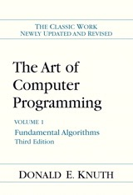
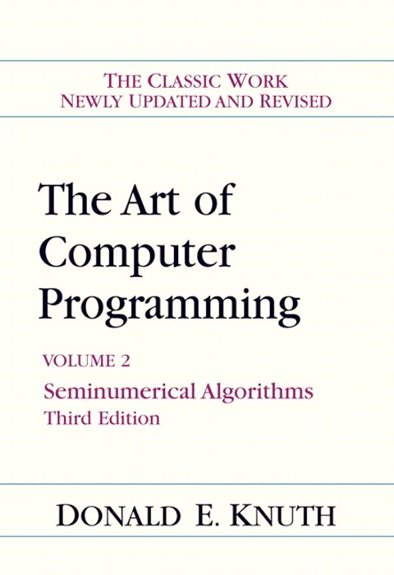
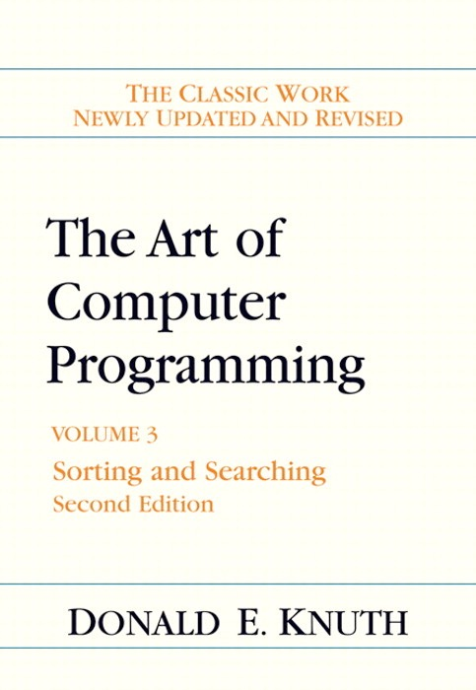
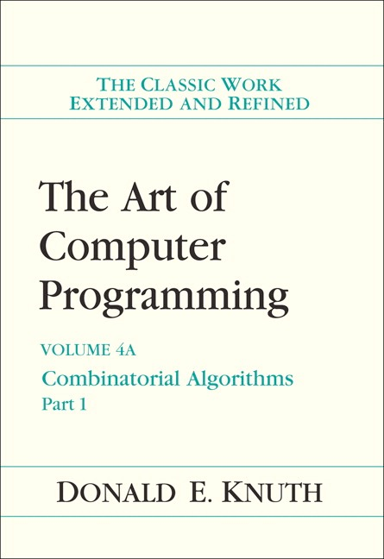
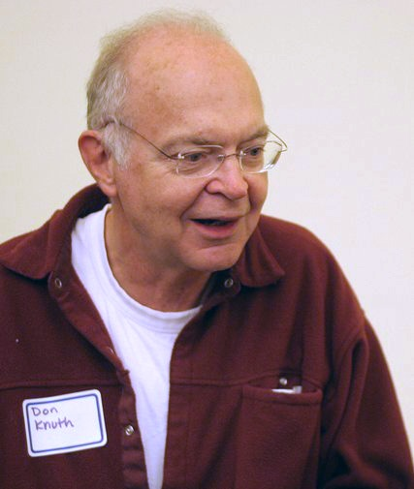
Mathematical models for running time
Q. Can we write down an accurate formula for the running time of a computer program?
A. (Prevailing wisdom, 1960s) No, too complicated.
A. (D. E. Knuth, 1968–present) Yes!
Determine the set of operations.
Find the cost of each operation (depends on computer and system software).
Find the frequency of execution of each operation (depends on algorithm and inputs).
Total running time: sum of cost × frequency for all operations.
Don Knuth 1974 Turing Award

Slide 23
Warmup: 1-sum
Identify the basic operations in an algorithm and determine the running time of an algorithm by counting its basic operations.
LO 11.1c
public static int count(int[] a)
{
int N = a.length;
int cnt = 0;
for (int i = 0; i < N; i++)
if (a[i] == 0)
cnt++;
return cnt;
}
operation | cost | frequency
function call/return | 20 ns | 1
variable declaration | 2 ns | 2
assignment | 1 ns | 2
less than compare | 1/2 ns | N + 1
equal to compare | 1/2 ns | N
array access | 1/2 ns | N
increment | 1/2 ns | between N and 2N
Note that frequency of increments
depends on input.
representative estimates (with some poetic license);
knowing exact values may require study and experimentation.
Q. Formula for total running time ?
A. cN + 26.5 nanoseconds, where c is between 2 and 2.5, depending on input.
Notes:
(11.1c) Identify the basic operations in an algorithm and determine the running time of an algorithm by counting its basic operations.
consider putting in instruction counts for N = 10000

Slide 24
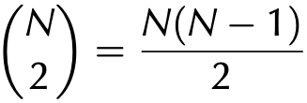
Warmup: 2-sum
operation | cost | frequency
function call/return | 20 ns | 1
variable declaration | 2 ns | N + 2
assignment | 1 ns | N + 2
less than compare | 1/2 ns | (N + 1) (N + 2)/2
equal to compare | 1/2 ns | N (N − 1)/2
array access | 1/2 ns | N (N − 1)
increment | 1/2 ns | between N (N + 1)/2 and N ²
public static int count(int[] a)
{
int N = a.length;
int cnt = 0;
for (int i = 0; i < N; i++)
for (int j = i+1; j < N; j++)
if (a[i] + a[j] == 0)
cnt++;
return cnt;
}
exact counts tedious to derive
# i < j =
Q. Formula for total running time ?
A. c1N² + c2N + c3 nanoseconds, where... [complicated definitions].
Notes:
consider putting in instruction counts for N = 10000

Slide 25
Simplifying the calculations
Tilde notation
Use only the fastest-growing term.
Ignore the slower-growing terms.
Rationale
When N is large, ignored terms are negligible.
When N is small, everything is negligible.
Def. f(N) ~ g(N) means f(N)/g(N) ➛ 1 as N ➛ ∞
Ex. 5/4 N² + 13/4 N + 53/2
~ 5/4 N²
1,250,000
for N = 1,000,
within .3%
1,253,276.5
for N = 1,000
Q. Formula for 2-sum running time when count is not large (typical case)?
A. ~5/4 N² nanoseconds.
eliminate dependence on input

Slide 26
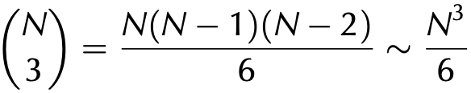
Mathematical model for 3-sum
operation | cost | frequency
function call/return | 20 ns | 1
variable declaration | 2 ns | ~N
assignment | 1 ns | ~N
less than compare | 1/2 ns | ~N³/6
equal to compare | 1/2 ns | ~N³/6
array access | 1/2 ns | ~N³/2
increment | 1/2 ns | ~N³/6
public static int count(int[] a)
{
int N = a.length;
int cnt = 0;
for (int i = 0; i < N; i++)
for (int j = i+1; j < N; j++)
for (int k = j+1; k < N; k++)
if (a[i] + a[j] + a[k] == 0)
cnt++;
return cnt;
}
# i < j < k =
assumes count
is not large
Q. Formula for total running time when return value is not large (typical case)?
A. ~ N³/2 nanoseconds.
✓
matches 4.84 × 10 ⁻¹⁰ × N³ empirical hypothesis
Notes:
consider putting in instruction counts for N = 10000

Slide 27

Comparing algorithms
Recognize typical orders of complexity (O(1), O(log n), O(n), O(n log n), O(n^2), O(n^3), O(2^n))
LO 11.1b
This Photo by Unknown Author is licensed under CC BY-SA
Q. Order algorithms from slowest to fastest
A. n! > 2^{n} > n^{n} > n log n > n > log n > 1
Notes:
(11.1b) Recognize typical orders of complexity (O(1), O(log n), O(n), O(n log n), O(n^2), O(n^3), O(2^n))

Slide 28
Classify Algorithms
LO 11.1e
Categorize algorithms according to their Big O complexity.
Q. Classify each of these algorithms using typical orders of complexity.
Algorithm. Find an element in a random array of N ints
N
Algorithm. Swap any two elements in an array of size N
1
Algorithm. Given N integers, find 3 integers that sums to zero
N³
Algorithm. Find an element in a sorted array of N ints
Log N
Algorithm. Given N elements, find all combinations
N!
Notes:
Categorize algorithms according to their Big O complexity.
consider putting in instruction counts for N = 10000

Slide 29
Counting basic operations
Identify the basic operations in an algorithm and determine the running time of an algorithm by counting its basic operations.
LO 11.1c
public static int count(int[] a)
{
int N = a.length;
int cnt = 0;
for (int i = 0; i < N; i++)
if (a[i] < 0)
cnt++;
return cnt;
}
1
1
1initialization, N+1 comparisons, N increments
N comparisons
0 to N increments
Q. What types of basic operations are performed in the code above?
A. Assignment (=) , comparison (<), increment (++)
Notes:
(11.1c) Identify the basic operations in an algorithm and determine the running time of an algorithm by counting its basic operations.

Slide 30
Counting operations
Express the running time of an algorithm as a function of the input size and derive the complexity class of the algorithm.
LO 11.1d
public static int count(int[] a)
{
int N = a.length;
int cnt = 0;
for (int i = 0; i < N; i++)
for (int j = i+1; j < N; j++)
if (a[i] + a[j] == 0)
cnt++;
return cnt;
}
Counting comparisons (==) operations (if statement)
i j operations
0 1….N-1 N-1
2…N-1 N-2
3…N-1 N-3
.
.
N-2 N-1..N-1 1
N-1 N..N-1 0
Total Comparisons = (N-1 ) + (N-2) + … + 2 + 1
~ N²
Running time is proportional to: N²
Complexity class of the algorithm: N²
Q. What types of basic operations are performed in the code above?
A. Assignment (=) , comparison (<, ==), addition (+)
increment (++)
Notes:
(11.1d) Express the running time of an algorithm as a function of the input size and derive the complexity class of the algorithm.
consider putting in instruction counts for N = 10000

Slide 31
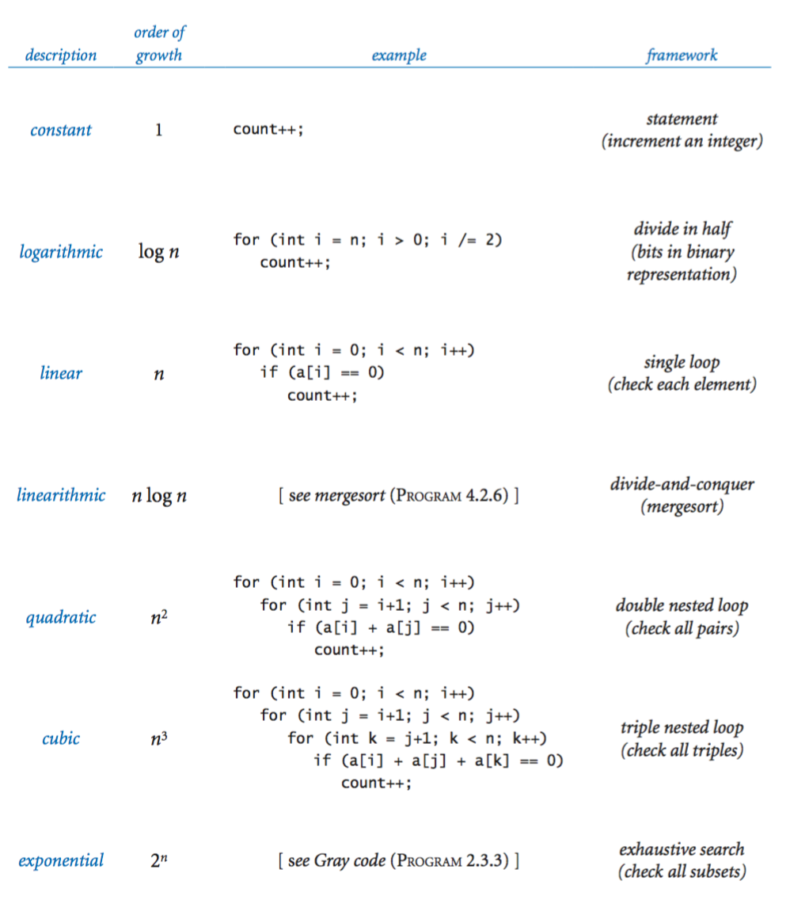
Common order-of-growth hypothesis
Categorize algorithms according to their Big O complexity.
LO 11.1e
Patterns. Look for specific framework to determine order-of-growth.
Notes:
(11.1e) Categorize algorithms according to their Big O complexity.
consider putting in instruction counts for N = 10000

Slide 32
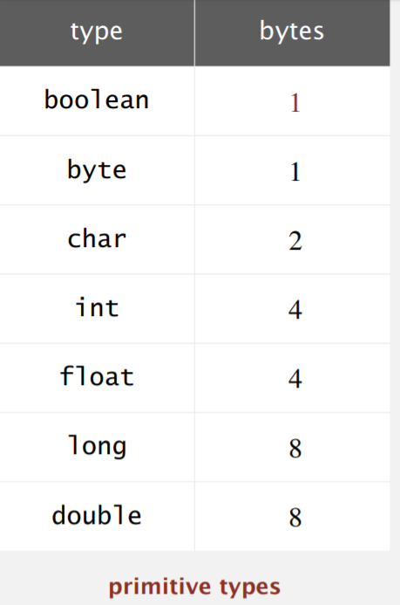
Time and space efficiency
Describe space and time efficiency tradeoffs when designing algorithms.
LO 11.1f
Time efficiency. How fast a program runs (on average)?
Space efficiency. How much memory is used by a program (on average)?
Typical memory used by primitive types
Notes:
(11.1f) Describe space and time efficiency tradeoffs when designing algorithms.
consider putting in instruction counts for N = 10000

Slide 33
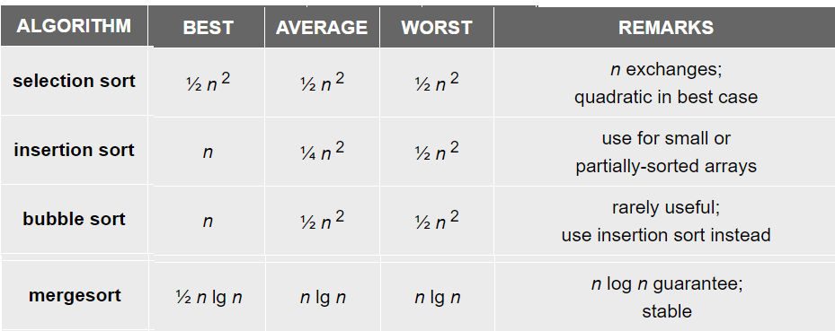
Finding best, average and worst cases
Identify the best case, worst case, and average case Big O complexities of algorithms.
LO 11.1g
Best case. Describe the performance of an algorithm under optimal conditions.
Worst case. A safe analysis of the performance of an algorithm under worst conditions.
Average case. A safe analysis of the performance of an algorithm under average conditions.
Notes:
(11.1g) Identify the best case, worst case, and average case Big O complexities of algorithms.
consider putting in instruction counts for N = 10000

Slide 34
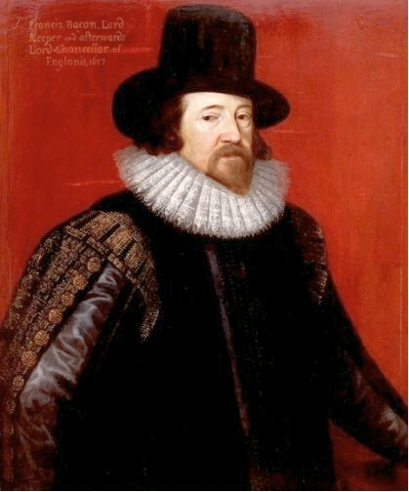
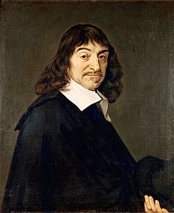
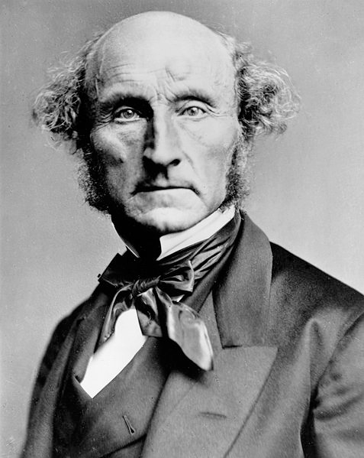
Context
Scientific method
Observe some feature of the natural world.
Hypothesize a model consistent with observations.
Predict events using the hypothesis.
Verify the predictions by making further observations.
Validate by refining until hypothesis and observations agree.
Francis Bacon
1561–1626
René Descartes
1596–1650
John Stuart Mill
1806–1873
Empirical analysis of programs
"Feature of natural world" is time taken by a program on a computer.
Fit a curve to experimental data to get a formula for running time as a function of N.
Useful for predicting, but not explaining.
Mathematical analysis of algorithms
Analyze algorithm to develop a formula for running time as a function of N.
Useful for predicting and explaining.
Might involve advanced mathematics.
Applies to any computer.
Good news. Mathematical models are easier to formulate in CS than in other sciences.

Slide 35
7. Performance
The challenge
Empirical analysis
Mathematical models
Doubling method
Familiar examples

Slide 36

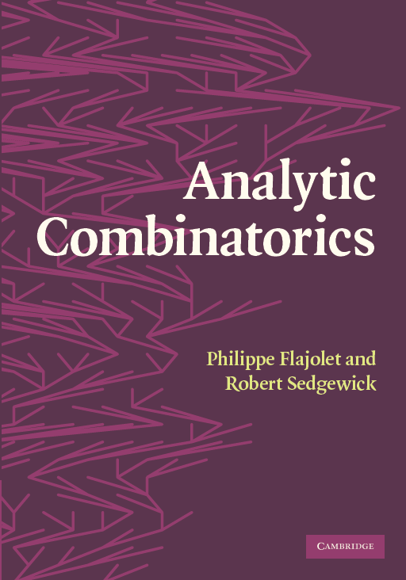
Key questions and answers
Q. Is the running time of my program ~ a N^{b} seconds?
A. Yes, there's good chance of that. Might also have a (lgN)^{c} factor.
Q. How do you know?
A. Computer scientists have applied such models for decades to many, many specific algorithms and applications.
A. Programs are built from simple constructs (examples to follow).
A. Real-world data is also often simply structured.
A. Deep connections exist between such models and a wide variety of discrete structures (including some programs).

Slide 37
?
?
?
?
?
?
?
?
?
?
?
?
?

Slide 38
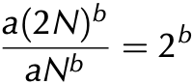
Doubling method
Hypothesis. The running time of my program is TN ~ a N^{b} .
no need to calculate a (!)
Consequence. As N increases, T2N/TN approaches 2^{b}.
Proof:
3-sum example
Doubling method
Start with a moderate size.
Measure and record running time.
Double size.
Repeat while you can afford it.
Verify that ratios of running times approach 2^{b}.
Predict by extrapolation:
multiply by 2^{b} to estimate T2N and repeat.
N | TN | TN/TN/2
1000 | 0.5
2000 | 4 | 8
4000 | 31 | 7.75
8000 | 248 | 8
16000 | 248 × 8 = 1984 | 8
32000 | 248 × 8² = 15872 | 8
...
1024000 | 248 × 8⁷ = 520093696 | 8
✓
math model says
running time
should be aN³
2³ = 8
Bottom line. It is often easy to meet the challenge of predicting performance.

Slide 39



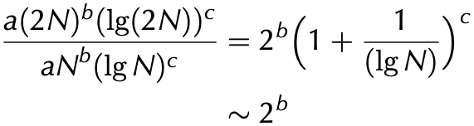
Caveats
It is sometimes not so easy to meet the challenge of predicting performance.
We need more terms in the math model: N lg N + 100N?
There are many other apps running on my computer!
What happens when the leading term oscillates?
Your input model is too simple: My real input data is completely different.
Your machine model is too simple: My computer has parallel processors and a cache.
Where’s the log factor?
Good news. Doubling method is robust in the face of many of these challenges.

Slide 40




Slide 41
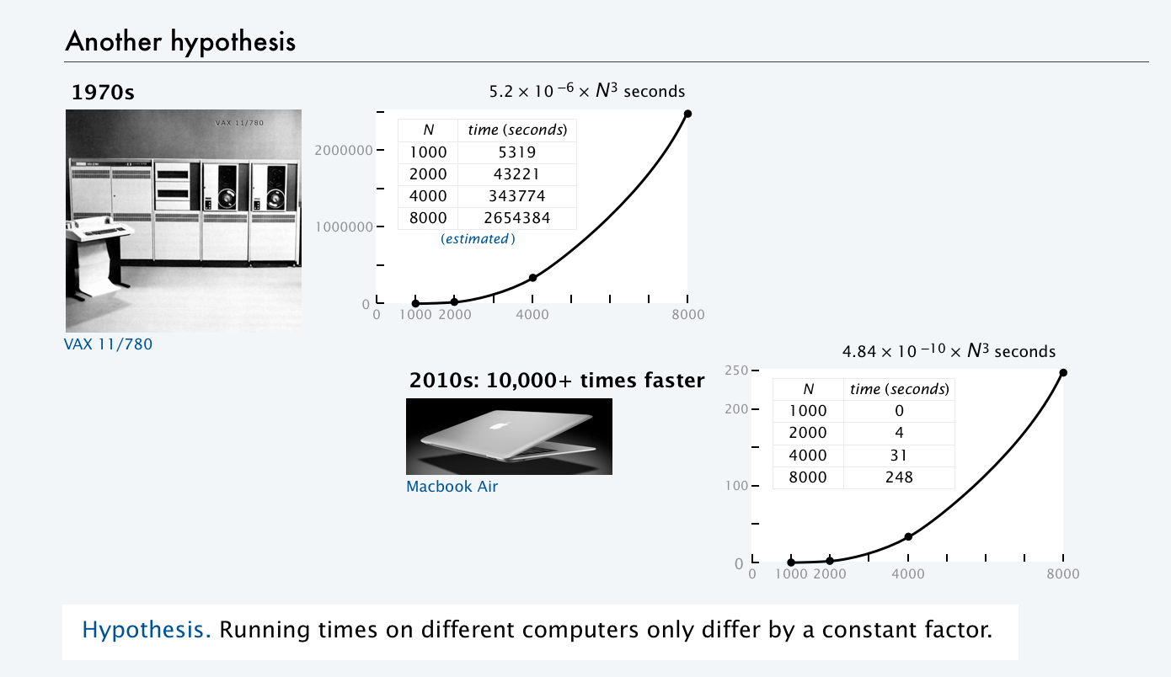
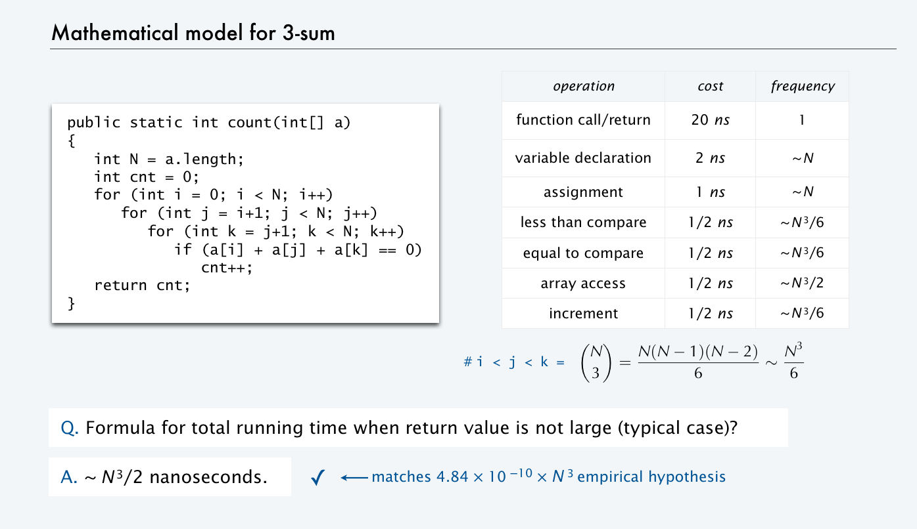
Order of growth
Def. If a function f(N) ~ ag(N) we say that g(N) is the order of growth of the function.
Hypothesis. Order of growth is a property of the algorithm, not the computer or the system.
Experimental validation
Explanation with mathematical model
When we execute a program on a computer that is X times
faster, we expect the program to be X times faster.
Machine- and system-dependent features of the model
are all constants.

Slide 42
Order of growth
Recognize typical orders of complexity (O(1), O(log n), O(n), O(n log n), O(n^2), O(n^3), O(2^n))
LO 11.1b
Hypothesis. The order of growth of the running time of my program is N^{b} (logN)^{c}.
log instead of lg
since constant base
not relevant
Evidence. Known to be true for many, many programs with simple and similar structure.
Linear (N)
Quadratic (N²)
Cubic (N³)
for (int i = 0; i < N; i++)
...
for (int i = 0; i < N; i++)
for (int j = i+1; j < N; j++)
for (int k = j+1; k < N; k++)
...
for (int i = 0; i < N; i++)
for (int j = i+1; j < N; j++)
...
Logarithmic (log N)
public static void f(int N)
{
if (N == 0) return;
... f(N/2)...
}
Linearithmic (N log N)
public static void f(int N)
{
if (N == 0) return;
... f(N/2)...
... f(N/2)...
for (int i = 0; i < N; i++)
...
}
Exponential (2^{N})
public static void f(int N)
{
if (N == 0) return;
... f(N-1)...
... f(N-1)...
}
Stay tuned for examples.
ignore for practical purposes (infeasible for large N )
Notes:
(11.1b) Recognize typical orders of complexity (O(1), O(log n), O(n), O(n log n), O(n^2), O(n^3), O(2^n))

Slide 43
Order of growth classifications
order of growth |  | slope of line in log-log plot (b) | factor for doubling method (2^{b})
description | function
constant | 1 | 0 | 1
logarithmic | logN | 0 | 1
linear | N | 1 | 2
linearithmic | N logN | 1 | 2
quadratic | N² | 2 | 4
cubic | N³ | 3 | 8
log-log plot
N³
N²
N
NlogN
Time
8T
4T
logN
2T
T
1
if input size doubles
running time increases
by this factor
 | 1K | 2K | 4K | 8K
Problem size
math model may
have log factor
If math model gives order of growth, use doubling method to validate 2^{b} ratio.
If not, use doubling method and solve for b = lg(TN/TN/2) to estimate order of growth to be N^{b}.

Slide 44
An important implication
Moore's Law. Computer power increases by a roughly a factor of 2 every 2 years.
Q. My problem size also doubles every 2 years. How much do I need to spend to get my job done?
a very common situation: weather prediction, transaction processing, cryptography...
 | now | 2 years from now | 4 years from now |  | 2M years from now
N | $X | $X | $X | ... | $X
N logN | $X | $X | $X | ... | $X
N² | $X | $2X | $4X | ... | $2^{M}X
N³ | $X | $4X | $16X | ... | $4^{M}X
Do the math
TN = aN³
running time today
T2N = (a/2)(2N)³
running time in 2 years
= 4aN³
= 4TN
A. You can't afford to use a quadratic algorithm (or worse) to address increasing problem sizes.

Slide 45
Meeting the challenge
Mine, too. I'm going to run a doubling experiment.
My program is taking too long to finish. I'm going out to get a pizza.
Hmmm. Still didn't finish.
The experiment showed my program to have a higher order of growth than I expected. I found and fixed the bug.
Time for some pizza!
Doubling experiments provide good insight on program performance
Best practice to plan realistic experiments for debugging, anyway.
Having some idea about performance is better than having no idea.
Performance matters in many, many situations.

Slide 46
Caveats
It is sometimes not so easy to meet the challenge of predicting performance.
We need more terms in the math model: N lg N + 100N?
There are many other apps running on my computer!
Your input model is too simple: My real input data is completely different.
What happens when the leading term oscillates?
Your machine model is too simple: My computer has parallel processors and a cache.
Where’s the log factor?
Good news. Doubling method is robust in the face of many of these challenges.

Slide 47
7. Performance
The challenge
Empirical analysis
Mathematical models
Doubling hypothesis
Familiar examples

Slide 48
Example: Gambler’s ruin simulation
Q. How long to compute chance of doubling 1 million dollars?
N | TN | TN/TN/2
1000 | 4
2000 | 17 | 4.25
4000 | 56 | 3.29
8000 | 286 | 5.10
16000 | 1172 | 4.09
32000 | 1172 × 4 = 4688 | 4
...
1024000 | 1172 × 4⁶ = 4800512 | 4
public class Gambler
{
public static void main(String[] args)
{
int stake = Integer.parseInt(args[0]);
int goal = Integer.parseInt(args[1]);
int trials = Integer.parseInt(args[2]);
double start = System.currentTimeMillis()/1000.0;
int wins = 0;
for (int i = 0; i < trials; i++)
{
int t = stake;
while (t > 0 && t < goal)
{
if (Math.random() < 0.5) t++;
else t--;
}
if (t == goal) wins++;
}
double now = System.currentTimeMillis()/1000.0;
StdOut.print(wins + " wins of " + trials);
StdOut.printf(" (%.0f seconds)\n", now - start);
}
}
✓
math model says
order of growth
should be N²
% java Gambler 1000 2000 100
53 wins of 100 (4 seconds)
% java Gambler 2000 4000 100
52 wins of 100 (17 seconds)
% java Gambler 4000 8000 100
55 wins of 100 (56 seconds)
% java Gambler 8000 16000 100
53 wins of 100 (286 seconds)
A. 4.8 million seconds (about 2 months).
% java Gambler 16000 32000 100
48 wins of 100 (1172 seconds)

Slide 49
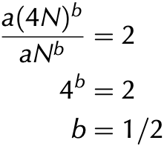
Another example: Factoring
Q. How large a number can I factor in a day (86,400 seconds)?
N | TN | TN/TN/4
2⁵⁸ + 69 | 12
2⁵⁹ + 131 | 18
2⁶⁰ + 33 | 25 | 2.08
2⁶¹ + 15 | 35 | 1.94
2⁶² + 135 | 49 | 1.96
... |  | 2
2⁸⁴ + ... | 49 × 2¹¹ = 100352 | 2
public class Factors
{
public static void main(String[] args)
{
double start = System.currentTimeMillis()/1000.0;
long N = Long.parseLong(args[0]);
for ( long i = 2; i <= N/i; i++)
{
while (N % i == 0)
{
System.out.print(i + " ");
N = N / i;
}
}
double now = System.currentTimeMillis()/1000.0;
long time = Math.round(now - start);
if (N > 1) System.out.print(N);
else System.out.print();
StdOut.println(" (" + time + " seconds)");
}
}
✓
Tricky: math model says
order of growth
should be √N
% java Factors 288230376151711813
288230376151711813 (12 seconds)
% java Factors 576460752303423619
576460752303423619 (18 seconds)
% java Factors 1152921504606847009
1152921504606847009 (25 seconds)
% java Factors 2305843009213693967
2305843009213693967 (35 seconds)
% java Factors 4611686018427388039
4611686018427388039 (49 seconds)
A. About 2⁸⁴ (26 digits).

Slide 50
Pop quiz on performance
Q. Let TN be the running time of program Mystery and consider these experiments:
public class Mystery
{
public static void main(String[] args)
{
...
int N = Integer.parseInt(args[0]);
...
}
}
N | TN (in seconds) | TN/TN/2
1000 | 5
2000 | 20 | 4
4000 | 80 | 4
8000 | 320 | 4
Q. Predict the running time for N = 64,000.
Q. Estimate the order of growth.

Slide 51
Pop quiz on performance
Q. Let TN be the running time of program Mystery and consider these experiments.
public class Mystery
{
public static void main(String[] args)
{
...
int N = Integer.parseInt(args[0]);
...
}
}
N | TN (in seconds) | TN/TN/2
1000 | 5
2000 | 20 | 4
4000 | 80 | 4
8000 | 320 | 4
16000 | 320 × 4 = 1280 | 4
32000 | 1280 × 4 = 5120 | 4
64000 | 5120 × 4 = 20480 | 4
Q. Predict the running time for N = 64,000.
A. 20480 seconds.
Q. Estimate the order of growth.
A. N², since lg 4 = 2.

Slide 52
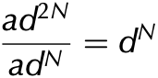
Trick question on performance
Q. Let TN be the running time of program Mystery and consider these experiemnts:
public static Mystery
{
...
int N = Integer.parseInt(args[0]);
...
}
N | TN (in seconds) | TN/TN/2
10 | 5
20 | 50 | 10
30 | 5000 | 100
40 | 50000000 | 10000
Q. Why is the ratio growing, not converging to a constant?
A. Order of growth is exponential.

Slide 53
Another example: Coupon collector
Q. How long to simulate collecting 1 million coupons?
N | TN | TN/TN/2
125000 | 7
250000 | 14 | 2
500000 | 31 | 2.21
1000000 | 31 × 2 = 63 | 2
public class Collector
{
public static void main(String[] args)
{
int N = Integer.parseInt(args[0]);
int trials = Integer.parseInt(args[1]);
int cardcnt = 0;
double start = System.currentTimeMillis()/1000.0;
for (int i = 0; i < trials; i++)
{
int valcnt = 0;
boolean[] found = new boolean[N];
while (valcnt < N)
{
int val = (int) (StdRandom() * N);
cardcnt++;
if (!found[val])
{ valcnt++; found[val] = true; }
}
}
double now = System.currentTimeMillis()/1000.0;
StdOut.printf(“%d %.0f “, N, N*Math.log(N) + .57721*N);
StdOut.print(cardcnt/trials);
StdOut.printf(" (%.0f seconds)\n", now - start);
}
}
✓
math model says
order of growth
should be NlogN
% java Collector 125000 100
125000 1539160 1518646 (7 seconds)
% java Collector 250000 100
250000 3251607 3173727 (14 seconds)
% java Collector 500000 100
500000 6849787 6772679 (31 seconds)
A. About 1 minute.
might run out of memory
trying for 1 billion
% java Collector 1000000 100
1000000 14392721 14368813 (66 seconds)
✓

Slide 54
Analyzing typical memory requirements
A bit is 0 or 1 and the basic unit of memory.
1 megabyte (MB) is about 1 million bytes.
1 gigabyte (GB) is about 1 billion bytes.
A byte is eight bits — the smallest addressable unit.
Primitive-type values
System-supported data structures (typical)
type | bytes
boolean | 1
char | 2
int | 4
float | 4
long | 8
double | 8
type | bytes
int[N] | 4N + 16
double[N] | 8N + 16
int[N][N] | 4N² + 20N + 16 ~ 4N²
double[N][N] | 8N² + 20N + 16 ~ 8N²
String | 2N + 40
Note: not 1 bit
Example. 2000-by-2000 double array uses ~32MB.

Slide 55
TEQ on Performance 6
How much memory does this program use (as a function of N)?
public class RandomWalk
{
public static void main(String[] args)
{
int N = Integer.parseInt(args[0]);
int[][] count = new int[N][N];
int x = N/2;
int y = N/2;
for (int i = 0; i < N; i++) {
// no new variable declared in loop
...
count[x][y]++;
}
}
}

Slide 56
TEQ on Performance 6
How much memory does this program use (as a function of N)?
public class RandomWalk
{
public static void main(String[] args)
{
int N = Integer.parseInt(args[0]);
int[][] count = new int[N][N];
int x = N/2;
int y = N/2;
for (int i = 0; i < N; i++) {
// no new variable declared in loop
...
count[x][y]++;
}
}
}
A. ∼ 4 N² bytes.

Slide 57
Summary
Use computational experiments, mathematical analysis, and the scientific method to learn whether your program might be useful to solve a large problem.
Q. What if it's not fast enough?
A.
does it scale?
yes
no
buy a new computer and solve bigger problems
learn a better algorithm
found one?
no
yes
invent a better algorithm
Plenty of new algorithms awaiting discovery.
Example: Solve 3-sum efficiently

Slide 58
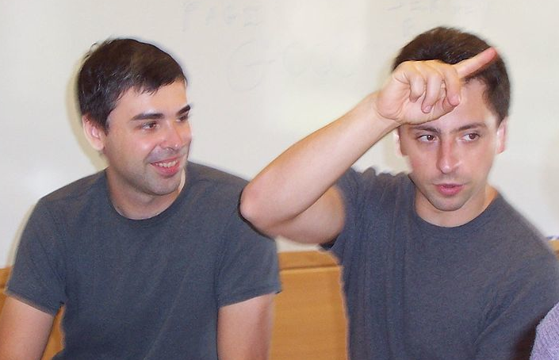
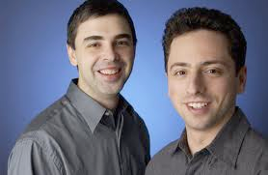

Case in point
Not so long ago, 2 CS grad students had a program to index and rank the web (to enable search).
does it scale?
yes
no
Larry Page and Sergey Brin
buy a new computer and solve bigger problems
learn a better algorithm
changing the world?
found one?
maybe
not yet
no
yes
PageRank (see Section 1.6)
yes
invent a better algorithm
Lesson. Performance matters!

Slide 59
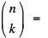
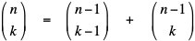
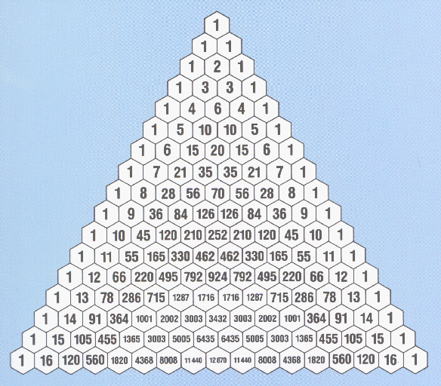
Binomial Coefficients
Binomial coefficient. number of ways to choose k of n elements.
Pascal's identity.
contains first element
excludes first element

Slide 60
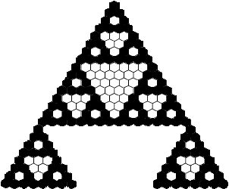
Binomial Coefficients: Sierpinski Triangle
Binomial coefficient. number of ways to choose k of n elements.
Sierpinski triangle. Color black the odd integers in Pascal's triangle.
Notes:
Recall recursive graphics assignment

Slide 61
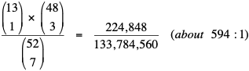
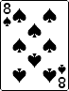
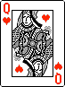
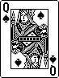
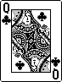
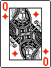
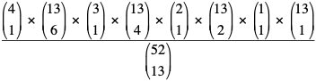
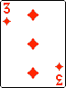
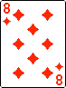

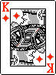








Binomial Coefficients: Poker Odds
Binomial coefficient. number of ways to choose k of n elements.
Probability of "quads" in Texas hold 'em:
Probability of 6-4-2-1 split in bridge:

Slide 62
Binomial Coefficients: First Attempt
public class SlowBinomial
{
// Natural recursive implementation
public static long binomial(long n, long k)
{
if (k == 0) return 1;
if (n == 0) return 0;
return binomial(n-1, k-1) + binomial(n-1, k);
}
public static void main(String[] args)
{
int N = Integer.parseInt(args[0]);
int K = Integer.parseInt(args[1]);
StdOut.println(binomial(N, K));
}
}

Slide 63
TEQ on Performance 3
Is this an efficient way to compute binomial coefficients?
public static long binomial(long n, long k)
{
if (k == 0) return 1;
if (n == 0) return 0;
return binomial(n-1, k-1) + binomial(n-1, k);
}

Slide 64
TEQ on Performance 3
Is this an efficient way to compute binomial coefficients?
public static long binomial(long n, long k)
{
if (k == 0) return 1;
if (n == 0) return 0;
return binomial(n-1, k-1) + binomial(n-1, k);
}
A. NO, NO, NO: same essential recomputation flaw as naive Fibonacci.
(50, 25)
(49, 24)
(49, 25)
(48, 23)
(48, 24)
(48, 24)
(48, 25)
(47, 22)
(47, 23)
(47, 23)
(47, 24)
(47, 23)
(47, 24)
(47, 24)
(47, 25)
recursion tree for naïve binomial function

Slide 65
TEQ on Performance 4
Let F(N) be the time to compute binomial(2N, N) using the naive algorithm.
Observation: F(N+1)/F(N) is about 4.
What is the order of growth of the running time?
public static long binomial(long n, long k)
{
if (k == 0) return 1;
if (n == 0) return 0;
return binomial(n-1, k-1) + binomial(n-1, k);
}

Slide 66
TEQ on Performance 4
Let F(N) be the time to compute binomial(2N, N) using the naive algorithm.
Observation: F(N+1)/F(N) is about 4.
What is the order of growth of the running time?
public static long binomial(long n, long k)
{
if (k == 0) return 1;
if (n == 0) return 0;
return binomial(n-1, k-1) + binomial(n-1, k);
}
A. EXPONENTIAL: a 4^{N}
Will not finish unless N is small.

Slide 67

Dynamic Programming
Key idea. Save solutions to subproblems to avoid recomputation.
Tradeoff. Trade (a little) memory for (a huge amount of) time.
k
0
1
2
3
4
0
1
0
0
0
0
1
1
1
0
0
0
2
1
2
1
0
0
n
3
1
3
3
1
0
4
1
4
6
4
1
5
1
5
10
10
5
6
1
6
15
20
15
20 = 10 + 10
binomial(n, k)

Slide 68
Binomial Coefficients: Dynamic Programming
public class Binomial
{
public static void main(String[] args) {
int N = Integer.parseInt(args[0]);
int K = Integer.parseInt(args[1]);
long[][] bin = new long[N+1][K+1];
// base cases
for (int k = 1; k <= K; k++) bin[0][K] = 0;
for (int n = 0; n <= N; n++) bin[N][0] = 1;
// bottom-up dynamic programming
for (int n = 1; n <= N; n++)
for (int k = 1; k <= K; k++)
bin[n][k] = bin[n-1][k-1] + bin[n-1][k];
// print results
StdOut.println(bin[N][K]);
}
}

Slide 69
TEQ on Performance 5
Let F(N) be the time to compute binomial(2N, N) using dynamic programming.
What is the order of growth of the running time?
for (int n = 1; n <= 2*N; n++)
for (int k = 1; k <= N; k++)
bin[n][k] = bin[n-1][k-1] + bin[n-1][k];

Slide 70

TEQ on Performance 5
Let F(N) be the time to compute binomial(2N, N) using dynamic programming.
What is the order of growth of the running time?
for (int n = 1; n <= 2*N; n++)
for (int k = 1; k <= N; k++)
bin[n][k] = bin[n-1][k-1] + bin[n-1][k];
A. Quadratic: a N²
Effectively instantaneous for small N.
Key point: There is PROFOUND DIFFERENCE between 4^{N} and N²
cannot solve
a large problem
can solve
a large problem

Slide 71
Empirical Analysis
Timing experiments for computing binomial coefficients.
2N N | direct recursive solution | dynamic programming
26 13 | 0.46 | instant
28 14 | 1.27 | instant
30 15 | 15.69 | instant
32 16 | 57.4 | instant
34 17 | 230.42 | instant
( )
( )
( )
( )
( )
( )
increase n by 1, running time increases by about 4x
Notes:
Run ThreeSum.java in class from the command-line and wait for it to finish, perhaps up to N = 4096.
Ask students to make predictions.

Slide 72

In the real world: Stirling's Approximation
Why not use the formula to compute binomial coeffiecients?
Doesn’t work: 52! overflows a long, even though final result doesn't.
Instead of computing exact values, use Stirling's approximation:
:
approach | order of growth of running time | comment
recursive | 2^{N} | useless unless N is very small
dynamic programming | N² | best way to get exact answer
direct from formula | N | no good for large N (overflow)
Stirling’s approximation | constant | extremely accurate in practice

Slide 73

Memory

Slide 74
Java ArrayList Class

Slide 75
Java ArrayList
As arrays an ArrayList also store large amounts of data in a single collection that can be referred to with a single variable.
The ArrayList class provides a dynamic array implementation
stores objects of the same type sequentially
grows as needed (double its size)
useful if the size of the array is unknown
implements the List interface
To declare an ArrayList
ArrayList <E> arrayReferenceVariable;
Item data type

Slide 76
Java ArrayList
An ArrayList implements the List interface
ArrayLists can only hold objects, and not primitive types such as ints.
Each element in the sequence can be accessed separately.
We can explicitly overwrite an object at a specified position in the sequence, thus changing its value.
We can inspect the object at a specified location in the sequence.
We can add an object into a specified position of the sequence.
We can add an object to the end of the sequence.
We can remove an object from a specified location in the sequence.

Slide 77
ArrayList operations
To declare and instantiate an ArrayList of Strings:
ArrayList<String> names = new ArrayList<String>();
int size()
returns the number of elements in this list
boolean add(x)
appends x to the end of list; returns true
void add(index, x)
inserts x at position index, sliding elements at position index and higher to the right. Adds 1 to their indices and adjusts size
E get(index)
returns the element at the specified position in this list.
E set(index, x)
replaces the element at index with x
returns the element formerly at the specified position
E remove(index)
removes element from position index, sliding subsequent elements to the left (subtracts 1 from their indices)
and adjusts size and returns the element at the specified position in this list.
E remove(obj)
removes element from position index, sliding subsequent elements to the left (subtracts 1 from their indices)
and adjusts size and returns the element at the specified position in this list.
int indexOf(obj)
If obj is found in the list, then the position number where it is found is returned.
If the obj is not found, then -1 is returned.

Slide 78
Array and ArrayList
0 | 1 | 2 | 3 | 4 | 5 | 6
5 | 7 | 2 | 9 | 4 | 3
Arrays are a fixed length.
ArrayLists grow and shrink as needed.
Arrays can hold primitive values or objects.
ArrayLists hold objects.
Copy items from index 3 to index 5 to the right => shift right
0 | 1 | 2 | 3 | 4 | 5 | 6
5 | 7 | 2 | 9 | 9 | 4 | 3
 | Array | ArrayList | Best case | Worst case
Can access each element separately | arr[i] | list.get(i); | O(1) | O(1)
Can explicitly overwrite an element in a specific position | arr[i] = "Tom"; | list.set(i,"Tom"); | O(1) | O(1)
Can add an object into a specified position in the sequence | If there is space, copy items i…length-1 to the right, then insert object into position i | list.add(i,”Joe”); | O(1) | O(n)
Can add an object to the end | If there is space, add object at the end (must keep track of last added element) | list.add("Joe"); | O(1) | O(n)
Can remove an object from a specified location | Copy items (i+1)…(length-1) to the left. Remove last element. | list.remove(i); | O(1) | O(n)

Slide 79
Problem 1
Write a method, numWordsOfLength, that has two parameters, an ArrayList<String> list, and an integer len. The method returns the number of words in list that are exactly len letters long.
For example,
If list = ["cat", "dog", "mouse", "rat", "frog"]
numWordsOfLength(list, 3) returns 3;
numWordsOfLength(list, 4) returns 1;
numWordsOfLength(list, 2) returns 0;

Slide 80
Problem 2
Write a method, removeWordsOfLength, that has two parameters, an ArrayList list, and an integer len. The method removes all words in list that are exactly len letters long.
For example,
If list = ["cat", "dog", "mouse", "rat", "frog"]
removeWordsOfLength(list, 3) results with list = ["mouse", "frog"]
removeWordsOfLength(list, 4) results with list = ["cat", "dog", "mouse", "rat"]
removeWordsOfLength(list, 2) results with list = ["cat", "dog", "mouse", "rat", "frog"]

Slide 81

Image sources
https://openclipart.org/detail/25617/astrid-graeber-adult-by-anonymous-25617
https://openclipart.org/detail/169320/girl-head-by-jza
https://openclipart.org/detail/191873/manga-girl---true-svg--by-j4p4n-191873
Image sources
http://commons.wikimedia.org/wiki/File:Babbages_Analytical_Engine,_1834-1871._(9660574685).jpg
http://commons.wikimedia.org/wiki/File:Charles_Babbage_1860.jpg
http://commons.wikimedia.org/wiki/File:John_Tukey.jpg
http://commons.wikimedia.org/wiki/File:Andrew_Apple_(FloC_2006).jpg
http://commons.wikimedia.org/wiki/File:Hubble's_Wide_View_of_'Mystic_Mountain'_in_Infrared.jpg
Image sources
http://commons.wikimedia.org/wiki/File:KnuthAtOpenContentAlliance.jpg
http://commons.wikimedia.org/wiki/File:Pourbus_Francis_Bacon.jpg
http://commons.wikimedia.org/wiki/File:Frans_Hals_-_Portret_van_René_Descartes.jpg
http://commons.wikimedia.org/wiki/File:John_Stuart_Mill_by_London_Stereoscopic_Company,_c1870.jpg
Image sources
http://commons.wikimedia.org/wiki/File:FEMA_-_2720_-_Photograph_by_FEMA_News_Photo.jpg
http://pixabay.com/en/lab-research-chemistry-test-217041/
http://upload.wikimedia.org/wikipedia/commons/2/28/Cut_rat_2.jpg
http://pixabay.com/en/view-glass-future-crystal-ball-32381/

Slide 82
11. Performance
The challenge
Empirical analysis
Mathematical models
Doubling method
Familiar examples
Adopted and modified from Slides by Sedgewick and Wayne

Slide 83
11. Performance
1.1–1.2

